Slide 1
COVid Touch APP
India Vs Covid Hackathon
Team SuccessCode_200ok::
CV ROHIT(2nd year IT)
Vamsi Mohan

Slide 2
IN NEED OF MAINTAINING SOCIAL DISTANCE AMONG PEOPLE AT ATMs AND SUPER-MARKETS FOR BETTER HEALTH
Problem statement

Slide 3
A model that keeps tracking the contacts made by our hands with different objects around us in the vicinity of the camera. Warning is delivered through a message when our hands are about to touch the face after being in contact with nearby objects. Cloud functions and camera connectivity will provide continuous monitoring of our actions.
ABSTRACT::

Slide 4
Necessity of our project
In our scenario, we considered ATMs and Shopping Markets are the places that need this model for regulation of the COVID-19 spread. Hand movements and sanitising of hands can be detected, thereby providing necessary information to him and other people who are up for visiting that place. Every detail of touching, timestamps and skeleton information is stored in a database and using cloud functions to trigger notifications to citizens whenever they touch their face without washing/sanitizing hands.
Link for Video Demo : https://youtu.be/iwSNO8O-xvY

Slide 5
Models used
Object detection models -Mask_RCNN, RCNN,SSD, YOLO
YOLO gives accurate results and faster
OpenCV
Darknet
Posenet

Slide 6
Benefits of using YOLO:
1. It is fast and accurate
2. It takes entire image into consideration thereby encodes contextual
information about its appearance
3. YOLO learns generalized information making it better than most of the
algorithms out there.
4. It divides a single frame into different regions for fastness.
5. End to end training network makes its performance better.
Disadvantages:
1. YOLO cannot recognise objects which are very close to each other

Slide 7
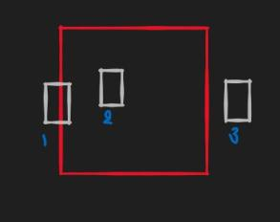
We used box overlapping method to detect touch and hand coming to face features of our project eg; if you assume red box as door and white box as hands then whenever in output white box touches/overlaps/comes inside the red box then it means hand to touched to door

Slide 8
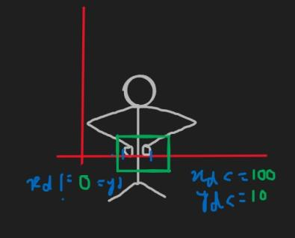
We used posenet to detect washing/sanitizing hands with calibrated measures for the actions following figure shown above is how we used the posenet as you can see we calibrated for the coordinated of wrist and skeleton of the arms/elbow(both left and right) to get close to accurate coordinates for washing/sanitizing action(custom model) and found out to be delta(x)<=100 and delta(y)<=10 taking modulus of difference. Posenet’s poses and skeleton helped for us to build a model out of it for custom washing/sanitizing actions

Slide 9
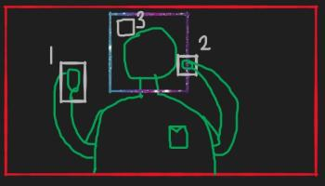
We used box overlapping method here too so if the white box(hand) touches/overlaps/comes inside of the blue box(face) then it means detection of had bringing closer is asserted and assuming red box to be the frame of pc/laptop

Slide 10
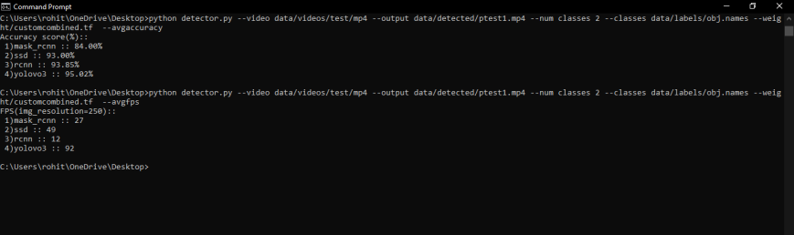

Slide 11
Scenarios
In ATM
In House
In Super-Market

Slide 12
InHome based
What it basically does is whenever you touch any item for suppose in your house say for example chair with your hand, it keeps tracking this through cc_cam context 24x7 .So whenever you touch your hand with chair then that info(metadata) will be send to database.

Slide 13
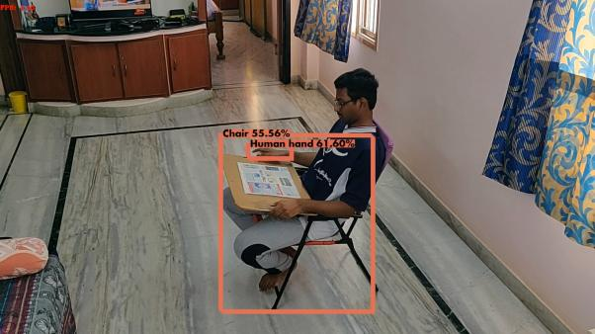
Touch

Slide 14
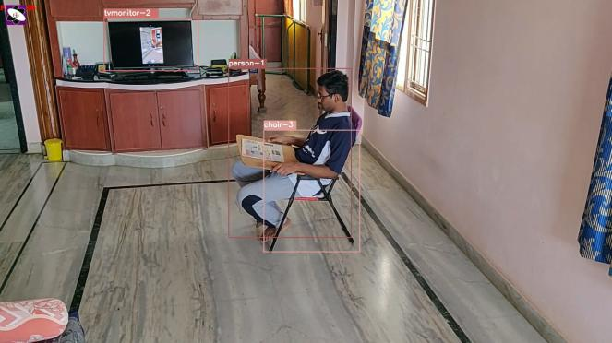

Slide 15
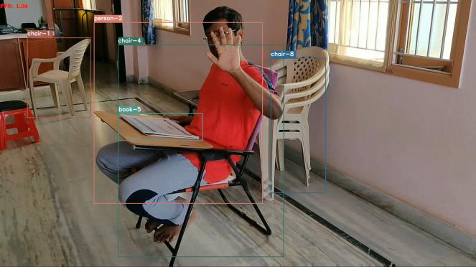

Slide 16
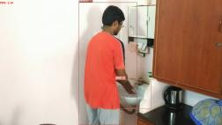
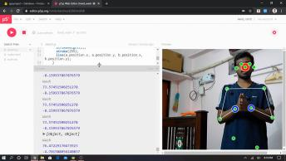
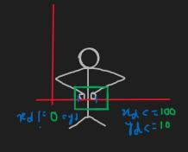
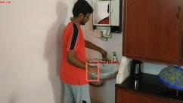
Wash and touch changed to 0

Slide 17
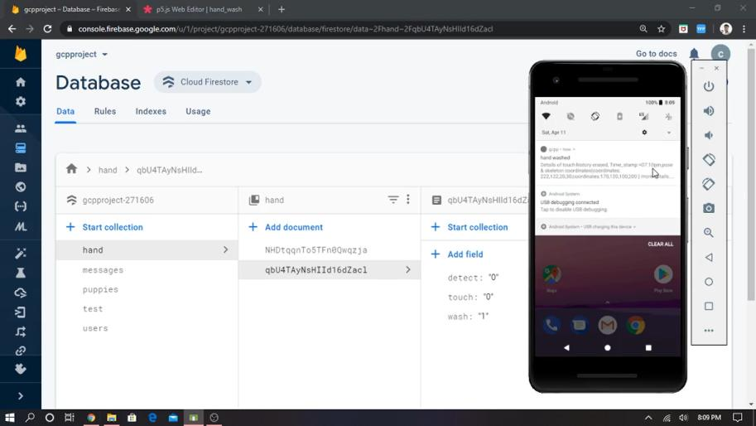

Slide 18

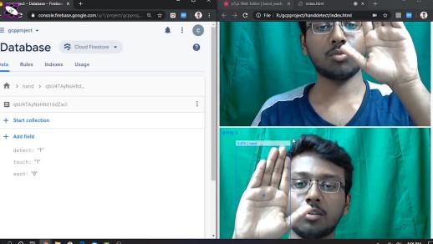
touch === '1' && detect === '1'

Slide 19
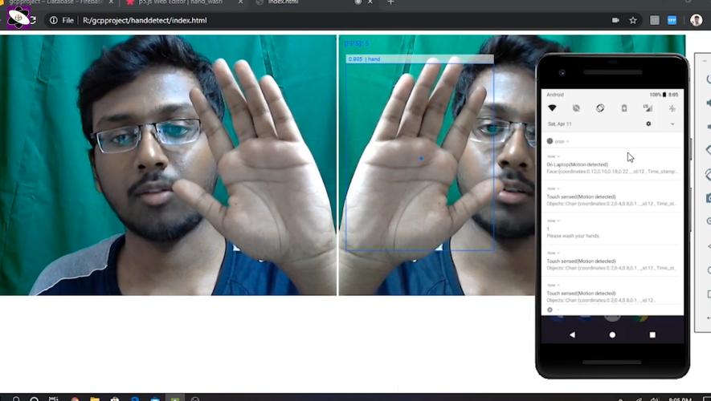

Slide 20
Fig: Table for decision making between the attributes
touch | wash | detect | Alert
0 | 0 | 0 | 0
0 | 0 | 1 | 0
0 | 1 | 0 | 0
0 | 1 | 1 | 0
1 | 0 | 0 | 0
1 | 0 | 1 | 1
1 | 1 | 0 | 0
1 | 1(↓) | 1 | 0
{0} | ←

Slide 21
ATM scenario

Slide 22
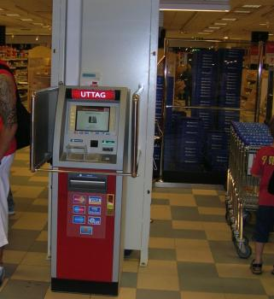

Slide 23
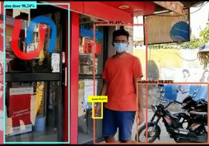
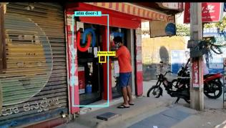
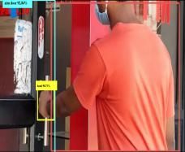
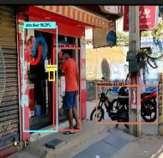
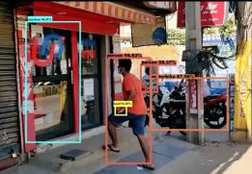

Slide 24
Where all Cloud functions and pub/sub::
1)Whenever touch is detected of human_hand with chair a cloud function is activated to change the Touch variable to 1 and store the metadata in the database
2)Whenever you wash your hands ,using posenet/ml5.js info of poses and skeleton CLoud function changes Wash value to 1 and store the wash metadata in database and changing Touch to 0
3)Whenever hand coming to face is detected then cloud function is used to change the Detect value to 1 and obviously not detected means again changing to 0 in real time
Later also checking to alarm or not by using the simply checking if both touch and detect attribute is 1 then only to shoot the alert

Slide 25
Back notes of notifications:
Here whenever
1)touch is detected notification is given to mobile regarding touch metadata info
2)whenever you washed then also notification is given that history erased and wash history with details(pose,skeleton info ,timestamps,etc)
3)Whenever detection is done(not washing) then notification saying wash your hands and also gives previous touch histories with wash details
4)Whenever detection is done(washing) then notification is given regarding wash details and touch history too(is present in cached data(redis))

Slide 26
Super-Market Scenario
Touches made with different objects around
Info to authorities via cc cameras
Sanitisation while entering into the super-market

Slide 27
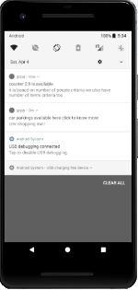
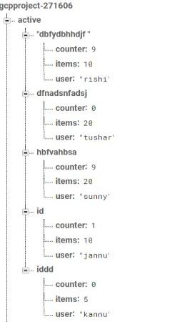
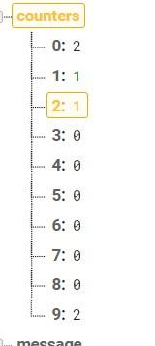

Slide 28
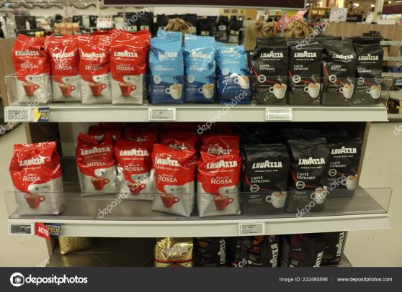

Slide 29
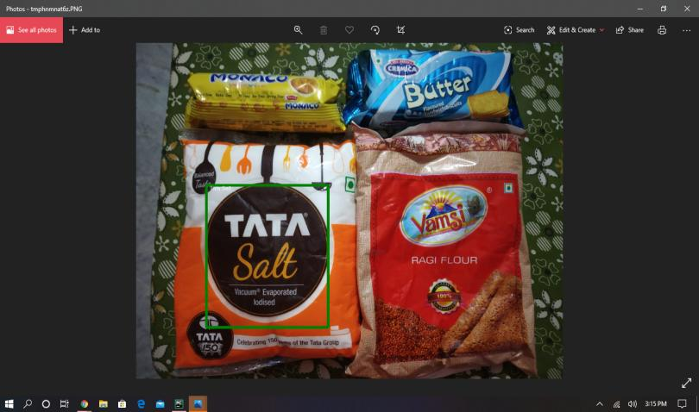

Slide 30
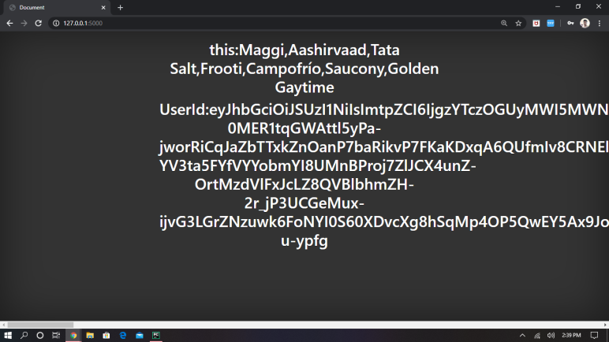

Slide 31
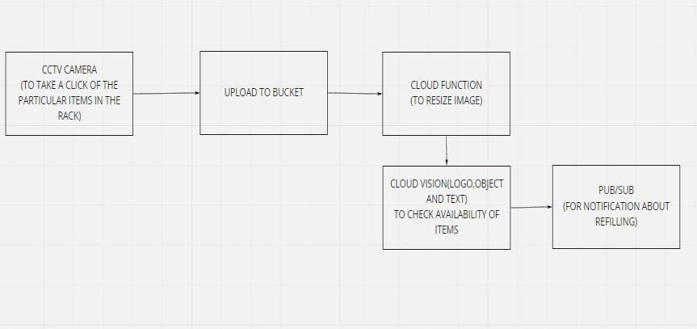

Slide 32
Social impacts
* So by using this model we can bring in small change in society by helping the people in terms of their touches and also helping the Police members and officials so they can track the covid positive person(X) travel,engagements history easily(“In telangana 1039 case found at present”) and tracking all the history is very difficult as person X may not be remembering when/where he met person Y ,etc and police need to investigate and thereby they are losing their right to be cared , so our App makes all that hustle eased away with the analysis and details of touch of things ,engagements,travel history,etc .
*Shopping markets/mall
*ATM’S
*Personel purpose and socio purposes

Slide 33
1)Police members and officials can track the covid positive person(X) travel,engagements history easily(“In telangana 1039 case found at present”and tracking all the history is very difficult as person X may not be remembering when/where he met person Y ,etc and police need to investigate and thereby they are losing their right to be cared , so our App makes all that hustle eased away with the analysis and details of touch of things ,engagements,travel history,etc )
2)A person who is authenticated with this app will be notified for his movements if he didn't wash his hands and he further be monitored in his home (using his laptop or anything in virtual env so that it will also be in the boundary of privacy). If he is bringing his hands closer to face or not after touching anything/coming from outside and not washing hands.
3) In the shopping market only the customer touched area can be sanitized instead of sanitizing all fruits/vegetables,as excessive sanitization of those also have adverse effects.
4)Can be used for road traffic detection of following social distance or not by using drones/Traffic cc_cams[2 people are at min distance away or not and analyzing from that]

Slide 34
5)Other Small features of App::
i)Regular notifications(to wash hands) based on your routine[Suppose daily you go to terrace for walk then after coming to home @ 7(AI) ]
ii)Build in Spam news filter for preventing wrong general/medical news[App provides news feed,or you can paste the title or link of the victim news and it will say how accurate it is]
iii)Intimate covid positive person nearby your area,if he is signed in with your app
iv)Can donate to needy by placing food at some location,and needy can see that location throughout the displays kept outside hotels/ATM and receive the food/ration following social distancing ,though door to door option also can be done.

Slide 35
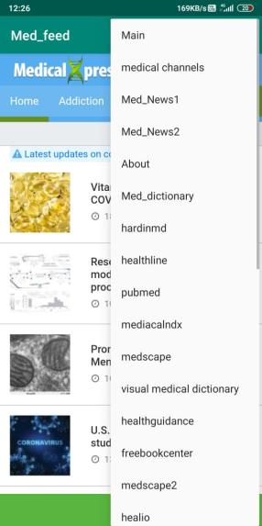
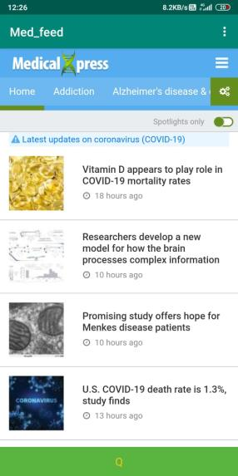

Slide 36
Conclusion
Finally based on experimental analysis and best fit conditions we preferred Yolov3 with pretrained model and custom training weights(Transfer learning) is best fit compared to other algorithms like: mask-rcnn,ssd,rcnn. Yolov3 fastness and manageable accuracy is best suited for our goal.
A person who is authenticated with this app will be notified for his movements if he didn't wash his hands and he further be monitored in his home (using his laptop or anything in virtual env so that it will also be in the boundary of privacy).
Can be used for road traffic detection of following social distance or not by using drones/Traffic cc_cams,two person are at min distance away or not and analyzing from that.In ATM to see if the person is sanitized before and after transaction to avoid society and himself/herself respectively prone to Covid-19

Slide 37
The End
Link for Video Demo : https://youtu.be/iwSNO8O-xvY

